Slide 1
Data Science Capstone
03/23 Team Update
Sam Speake

Slide 2
Team Changes
Michael Price no longer on the Domain Team
Dropped Major & Class
AJ will be working with Javonte on the Domain Team
Outcomes
Teams are now evenly distributed
Improved collaboration inter-team and intra-team

Slide 3
Accomplished This Week
Dev Team
Using 80% of the data for training, 20% for testing
Added nearly all attributes to baseline ordinal regression
Derived time spent incarcerated attribute
Output and results on next slide
Can judge results using IBM’s AI Fairness 360
Dev & Stats Teams met
Gained an understanding of what outputs are needed between teams
Allows standardized incremental progress

Slide 4
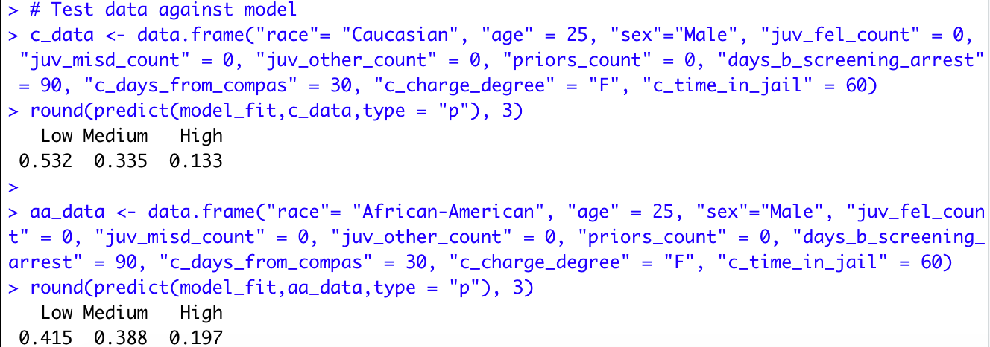
Example trained model output given two individuals who are identical other than race

Slide 5
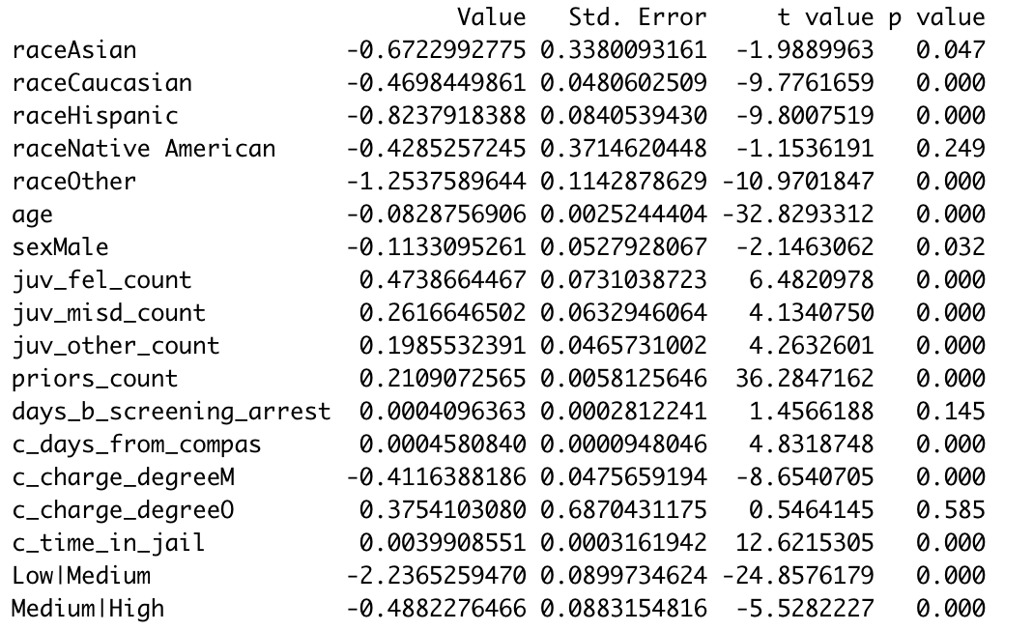
Model output with all attributes included

Slide 6
Questions Moving Forward
What should the dashboard look like?
Answers to the prior question may alleviate this one.
It is agreed the dashboard should be interactive, should the individual be able to
Enter sample attributes and see the output?
Pick an algorithm/regression (or multiple) and see outputs/differences?
Display AI Fairness output?
Etc
Which approach are we taking?
Using statistical/algorithmic methods to find which attributes (combinations of attributes) can be used to provide more accurate, less biased resultzs?
Looking for changes to the model which provide less biased results with the same attributes?

